Slide 1
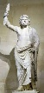
FBI
Partner
development
1990
NAVY(saylor)
41.Gorbache(nonPolicWife(micheal)§Tehft)
41.Grohcheo(§Dea.linsti(herion)
GORBACHEV
TYSON
JOSEPHE.MARY.(tootsie).depp (tranl) idiot
2013
STANFORD
GREEK MYTHOLOYGY
GOD.marx
Other:
*tophat
21 jumpstret, johnn depp
teenague mutant ninja turtels, shredder
howard the duck
gladitor
escap from alcatraz
alien nation
simpsons
last action hero
twin, arnonl schwazennger
tootsie, dustin hoffman
tuti frutti
moam
D.A.R.E to CRIMANL LAW
Bart 14
SQ.(van).CHECKPOINT CHALIE(Walmart)
1988/9
1988/9
1988/9
1988/9
1988/9
1988/9
1990
1989/9
1989/9
1991
1991/2
1991
41/83GOD(JOSPHE).QUEEN(ELKE).KING/queen.roth/roth/jobs/jobs/meiers/meiers/meiers/emielrs.
SQ.ghcoheo(action Jackson)
Pope St Fraci(stupido):
Larkspu tv jewel store guy runs out
Pope StinFranc (in stupido) Giy tells
Wife tuy is action jackosn, runs out
Leaves popele behind
2013
*tophat
IPX Pope St Fraci(stupido): popo fik
IPX Pay by ass
FACEBOOK:80/443
0/0
X
[x]no
Roth(Watson).IBM.presentatin
Ghoche(IBM.LIPSTICK).§Tehft.§DEA(herion)
[x] no

Slide 2
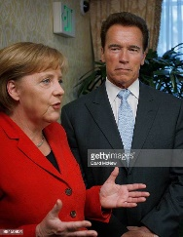
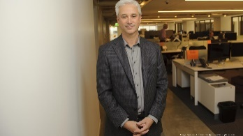
FBI
Partner
development
ANGELS( Mekle.marx)
CERTIFICATE:STANFORD:PMP
!BSc.CIVIL_CODE
CHECKPOINT CHARLIE(CHAIR VISA CHALIE)
MARKETING: Town Billbardos
$3 BILLLION
Gov. SCHWAZEGGER
King.PENIS
BUCK
Sub_subsumed: SEX SLAVE(S)
PUMP
x
JOSPHE.MARY.Dustin
1990 WWI.(tootsie).GOD(Gov. Schwaenegger).JOSEPH.MARY

Slide 3
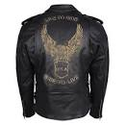
FBI
Partner
development
41.PENTAGON:FRANKURT:DEFAULT:RHEIN:MAIN
HOMCIDE:KYSTAL
JOSEPH.GOV.SCHWAENEGGER
1990 41WWI.MARX
000.tw.pns.BUNDES CHANLOR(thoms-is-dieter)
redhair
IBM.DL(moped). SOCIAL SEUCIRYT AMINSTRATAION
Ghvhoe(heger)
Retired at 30 started 15 appentichip
Davidon.marx(hells angels)
IBM, Damiller and Apple exlusion of Harley-Davision by
Busines violations in WWI
.Including Civil War as well as IPX(Interanat Post Exchange)
Austrians:
HOMCIDE:KYSTAL:JOPHSE:MARY
HOMCEP:KYSTAL(tootsie)
HOMICDI:IS-A-BELL

Slide 4
FBI
Partner
Dr. Dr. Prof
development
INTERNATIONAL
CIVIL CODE
JFK(BSc.Pentagon)

Slide 5
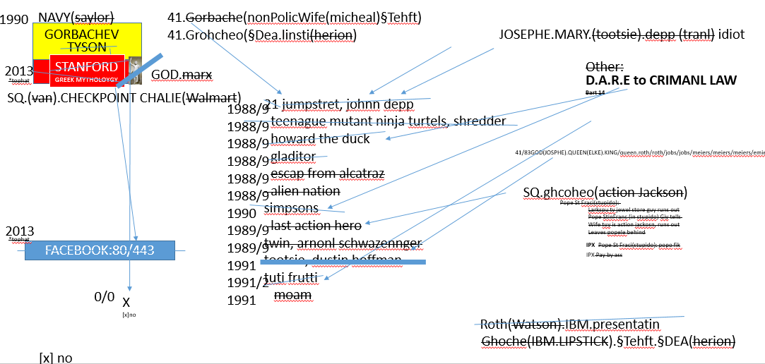
FBI
Partner
development
Trainee Joseph Headquarters(Mothership)
Mother 18
Mother ?
Mother 25
Horny Mother
Mother 30
x

Slide 6
FBI
Partner
FBI:WMD
development
41. PENTAGON VIRGINIA MARY (AVG)
Ghvohe(dyer)
O
p
41
Ghhceo(nonPowlieWife(mihceala)
Int.corp.phone.cisco.dept
Anglea
41
Int.corp.phone.cisco.dept
41
Int.corp.phone.cisco.dept
x

Slide 7
FBI
Partner
FBI:WMD
development
41. PENTAGON VIRGINIA MARY (AVG)
H
English Alphabet
41.JOSEPH.MARY
SEX WITH HATEHOLE

Slide 8
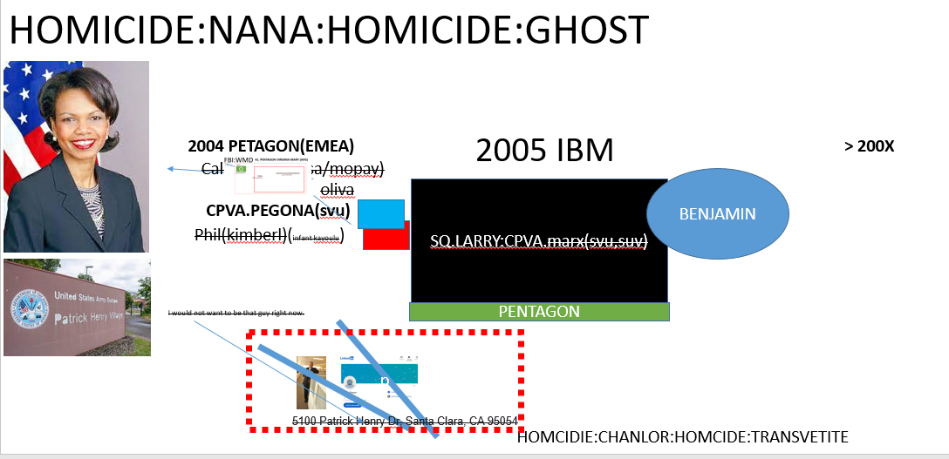
FBI
Partner
FBI:WMD
development
41. PENTAGON VIRGINIA MARY (AVG)
1987
FOSTER CITY, CALIFORNIA ( NAVY(Marlin Bld)
Ghvohe(dyer)
H
O
p
H
?
DR CONDOLEEZZA RICE: The Gorbachev December
1988 speech at the UN was really a turning point,
x
x
Onsite:
§SexAbuse
Oscar G.I.L.F
O
Gary
Offsite:
Chinese x/y
CHART
Herion: HOMICE:LUX:COINTOWN:HATEHOLE:COMPOUND INTERSTOWN
USAGE
NAME CHANGE(free/pizza)
x

Slide 9
FBI
Partner
COURT.nonPoliceCTX.ROLE
development
000.tw.pns.ROTH.nonPoclieChruth
FOSTER CITY, CALIFORNIA ( NAVY(Marlin Bld)
eval
p
Malpratice Roth,Watcon,Koche,etc
?
x
x
O
smog
Grany style
HOCMEP:NANA
Gary
Johson
The court creates
The scenrios using
Goment templates
i.e. HOMCIIDE, DEA, …
=>Data, avg layout[]

Slide 10
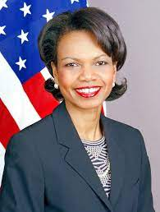
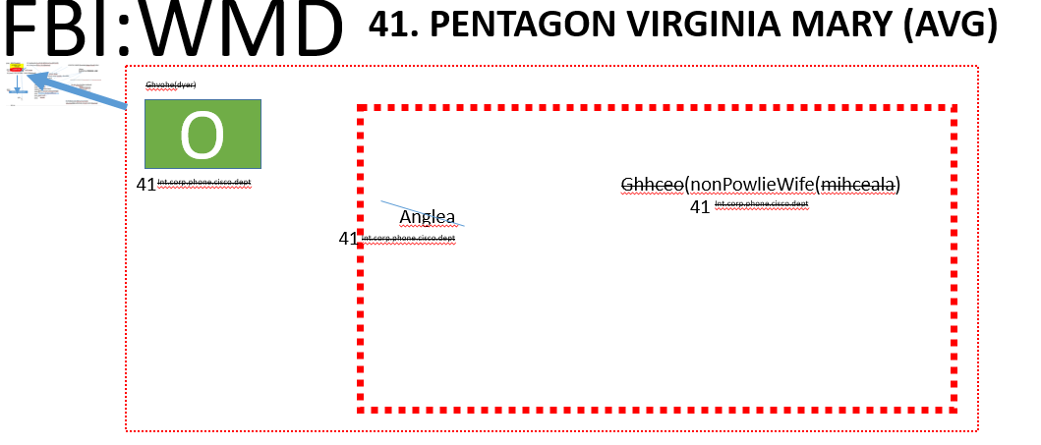
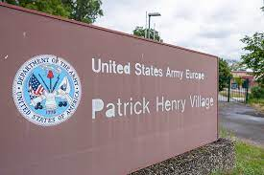
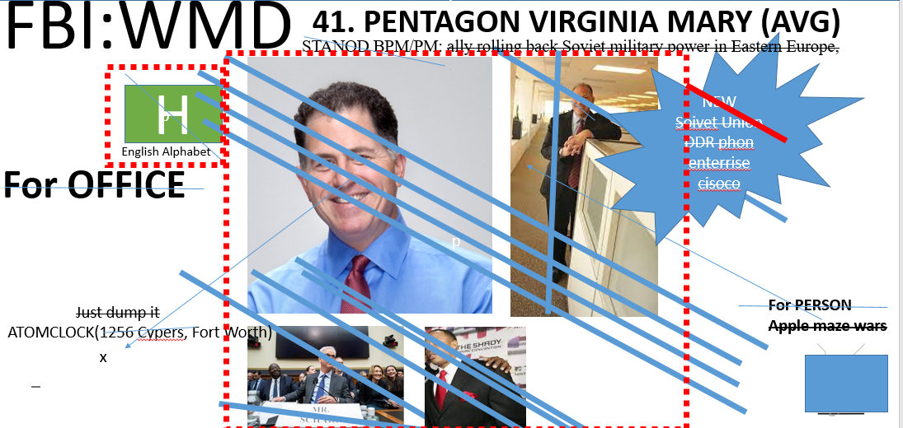
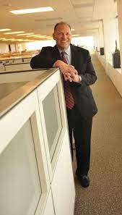
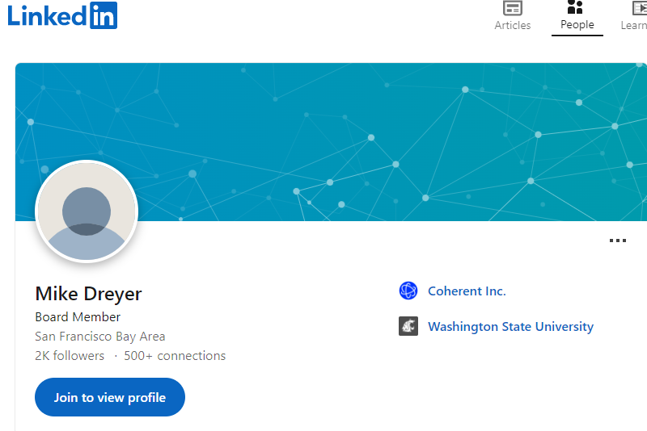
FBI
Partner
development
HOMICIDE:NANA:HOMICIDE:GHOST
2004 PETAGON(EMEA)
2005 IBM
> 200X
Call you rice(visa/mopay)
oliva
SQ.LARRY:CPVA.marx(svu,suv)
BENJAMIN
CPVA.PEGONA(svu)
Phil(kimberl)(infant kayoulu)
I would not want to be that guy right now.
PENTAGON
p
FBI:KIDDNPIGN(LARRY
.incase.old dirty basterd.no cube left behind)
5100 Patrick Henry Dr, Santa Clara, CA 95054
HOMCIDIE:CHANLOR:HOMCIDE:TRANSVETITE
Notes:
No child logcally left beind, edcutaion K-12

Slide 11
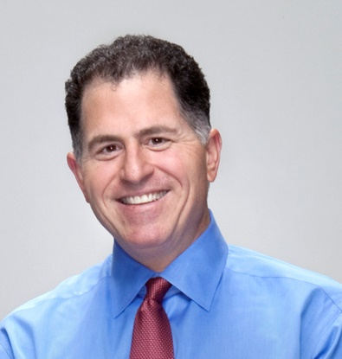
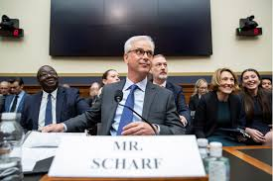
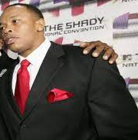
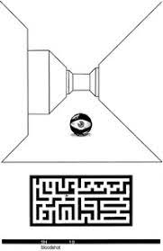
FBI
Partner
FBI:WMD
For OFFICE
development
41. PENTAGON VIRGINIA MARY (AVG)
NEW
Soivet Union
DDR phon enterrise cisoco
STANOD BPM/PM: ally rolling back Soviet military power in Eastern Europe,
p
p
H
English Alphabet
Just dump it
For PERSON
Apple maze wars
ATOMCLOCK(1256 Cypers, Fort Worth)
x

Slide 12
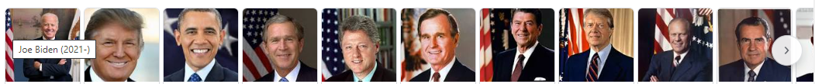
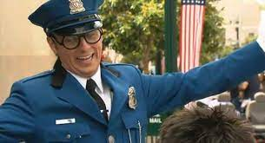
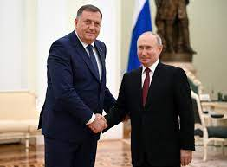

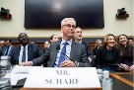
FBI
Partner
development
GOD.HOCMP:PETER:HOMCEP:JEUSE
FBI:KIDNAPPIGN:HOMCIDE:CHANLRO(CGEKCPOIN CHALRIRthose-is-dieter)))
FBI:WMD
FBI:WMD:CPVA
FBI:WMD
PUMP
Calc
Call you rice
TEST AGENT
Karl.SQ.COLMEMAN.LAKE TAHOE.marx
BAYRAM.DDR INFIOIN MEMORY
MAINSTREET(Ibm brieneley)
IBM Rerposnt Time Tracking (RT Agent)
VIRINIG (lee), Tivoli Austin, PwC
{
Auschitz

Slide 13
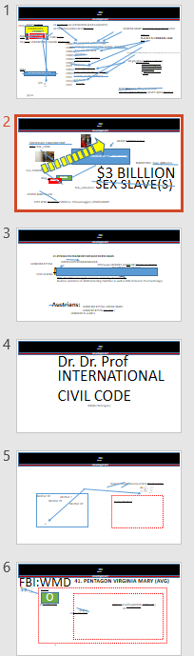
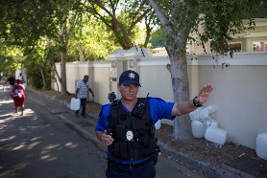
FBI
Partner
development
The federal government spent
over 300 billion dollars on
World War II,
CPVA
Bundespolizei-Stiftung Sparda-Bank West eG IBAN: DE51 3706 0590 0000 6836 80 BIC: GENODED1SPK
POLICE WATE AFRICA
HOMCPL:LUX:HOMCEP:MAYRO
Kontonummer, Aids, Religoin, CIVILA CODE, !§HATE CRIME 422.6
https://www.bundespolizei.de/Web/DE/05Die-Bundespolizei/12Bundespolizei-Stiftung/Bundespolizei-Stiftung_node.html
--Tim cook, asex john, niko johs

Slide 14
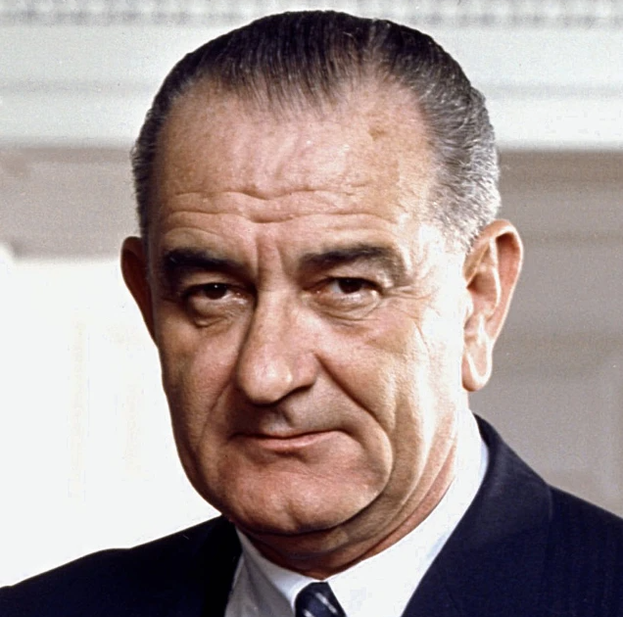
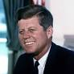
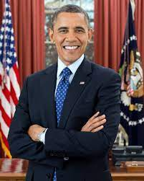
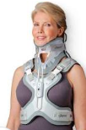
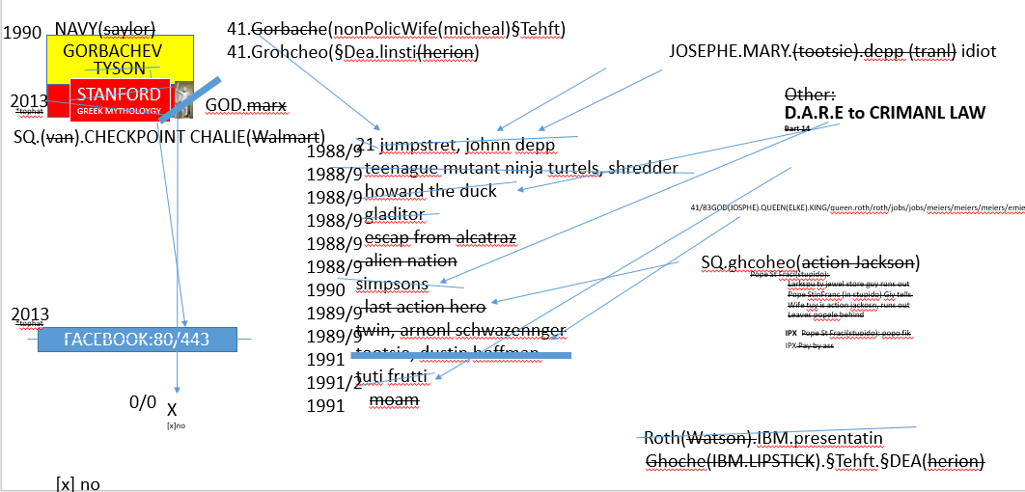
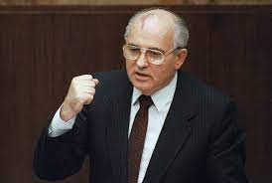
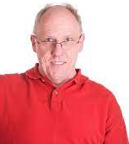
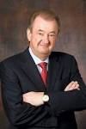
FBI
Partner
development
18 U.S. Code § 1751
I hear a voice.
Visa Angel: Voice
HOMCIDE:NANA:QUEEN
JFK.MLK
Phil.JOHONS.marx
JFK.BULLET.SHOOTER.”PENG”
PUMP
Iive!
Calc
We, Here a voice, Fort Worth
--Tim cook, asex john, niko johs
I am ricardo, from the ddr
St Pope Franc: he is a wall hopper, famlyy jumped over wall
McCarjty
.marx
McCarjty
.marx

Slide 15
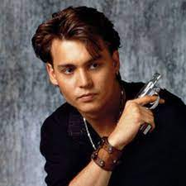


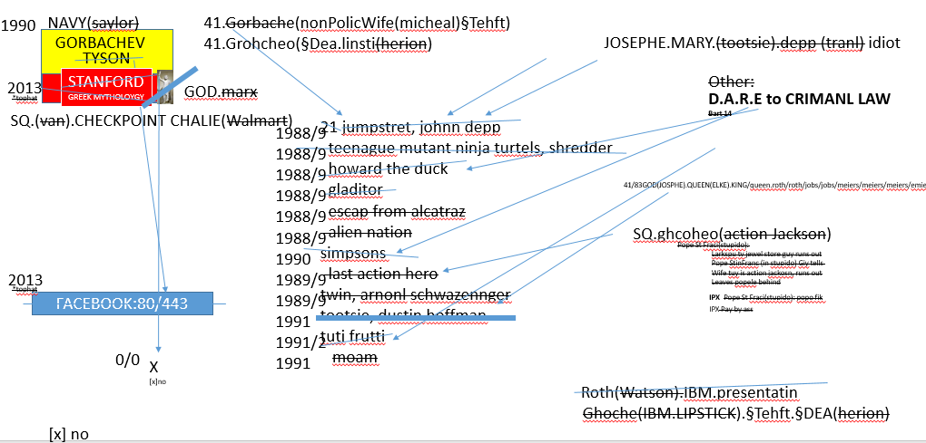
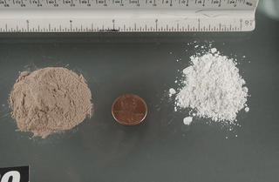
FBI
Partner
development
PENTAGON BASE PAUL – SPAIN/MEXICO
Patricia, HOMCIDE:BORIS
Until the Untilzen of Herion are Lying
On the Table( 2023 from the park or outside)
Pentagon Deere (phone)
2000 Professor PENTAGON BASE PAUL – SPAIN/MEXICO
2000 CHECKPOINT CHARLIE(HOMNEI_IS_A-BELL).PLANNING(travel to Berline Check point Calie)
VP GERMANY
ATOMBOMB(41/83.CPVA.nonPolcieWife)
JFK(zoo).VP GERMANY(BERLIN)
HOMICIDE:LUX:VHS(Polzei Berlin Zookologigarten)
GOD.Qeen.king.qeen.roth/roth/jpbbs./jobs
CHECKPINT CHALEI(0.1 suk my dig, Belguim)
INT:FBI:WMD:
EMEA
Stepnaie: Bis, das Spitzbestek auf
Dem Tish liegt Manuel,Kdwe(geukes)
Assuedm: VP GERMANY, ANGELA until he finds out, until the until of herion
Are on the table. Will we be gone.

Slide 16
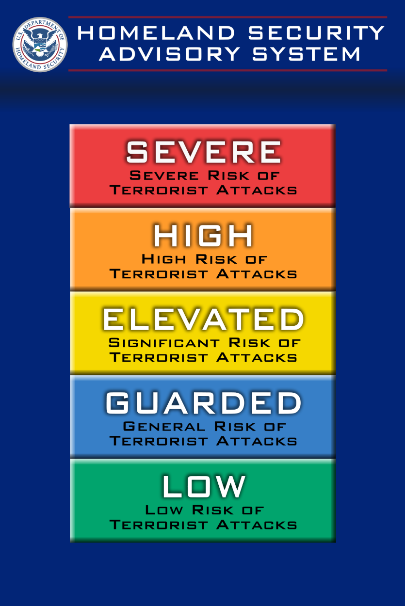
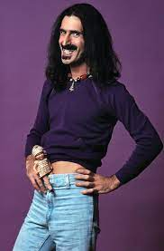
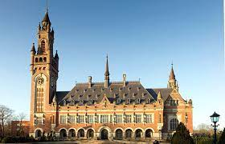
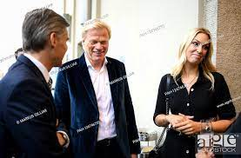
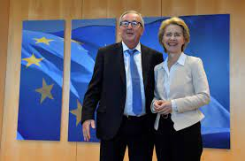
FBI
Partner
development
PENTAONG VIRIGINA MARY
EMEA CPVA (FREE/PIZZA)
Other: 41/83.CPVA; HOMICIDE:LUX:VHS(Polzei Berlin Zookologigarten)
FBI:WMD:CVPA
Exptorot Dr. Rice
nonPolcieCfg.SQ.COLEMAN(1996-2023)
Free
Pizza
VP GERMANY
z/os
z/app(freepizza FINAICAL
dttcc
VP NORTH KOREA
…
VP BELGUIM
VP SWEDEN
nonPolcieContentItem
GOD.(rmote)
400 Euro Checkin/Checkout EU anad
ingo wellenreuther in europaische unionb burssels
VP BELGUIM
Notes:
1D8723.iditon: We are taking care of shit hea I am hundyg . I wll go eat. Ther are peop in afraa.

Slide 17
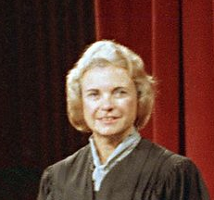

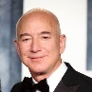

FBI
Partner
development
CIVIL CODE.LABOR CODE
subsumed: tango
stepnaie
DEA(fre/pizza).EU
cheinse stepnaie
2016 Prostietn Apple Chines Magage Stepane
2017 Proutetin Damiler.apple cheinse massage
Administrative
MAINSTREET(RHIN-MAIN:JOSPHE finance,IPX Sant clara)
KING.QUEEN.CPVA.JOSNPE.MARY(insetst)
Executive
CPVA.x
KING.QUEEN.CPVA.JOSNPE.MARY(insetst)
FEDERAL VP GEMANY(adoph hitler)
Other: 41.FEDER (Interutp) Applicatin
1D8723.x
Notes:
1D8723.iditon: We are taking care of shit hea I am hundyg . I wll go eat. Ther are peop in afraa.

Slide 18


FBI
Partner
development
Elastic Compute Cloud
Legislative
What do you like about?
Nintendo

Slide 19
FBI
Partner
development
40.CPVA.2019-2020
CHECKPON CHARLIE(FBI.DEFAULT.Woodstock/mayday)
rockefeller
r
1/2000.tw.pns.
CPVA.marx(0.01 is what you anwted
Phil(kimmerly).jenny PINK.pants FBI:KIDNAPPGIN
LAKE TAHOE.marx
watson
r
koche
watson
Ard tv nonPolciAuschtiz.avg
[x] no
Ghcoeh(maik)
Covers.avg.shame
Pissing Anita 1982 on people
co2
ATB.showers
roth
41.nonPolciPrisont(schulz,kling,ard)
000.marx
Cpva.(DAUHGER)
$ 3-Bedrom
rockefeller
rockefeller
co2
Ghchoeo(dell,ushe(saito, pope.lisa)
koche
roth

Slide 20
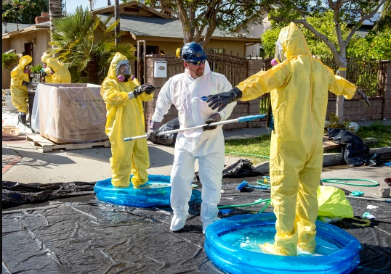
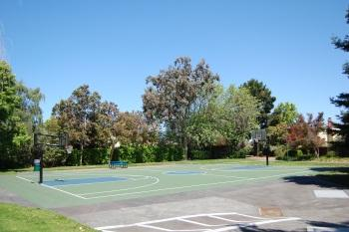
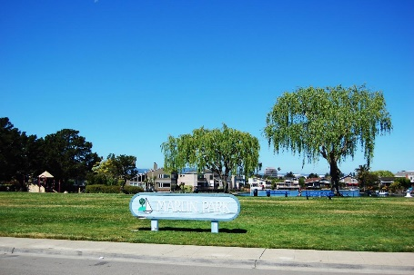
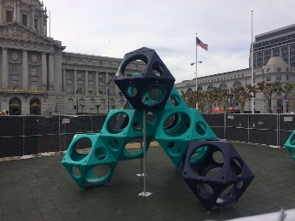
FBI
Partner
development
NAVY(marlin)
2000 Professor near PENTAGON BASE PAUL
2015 Patricia
ATOMBOMB(timer)
Free/pizza
other

Slide 21
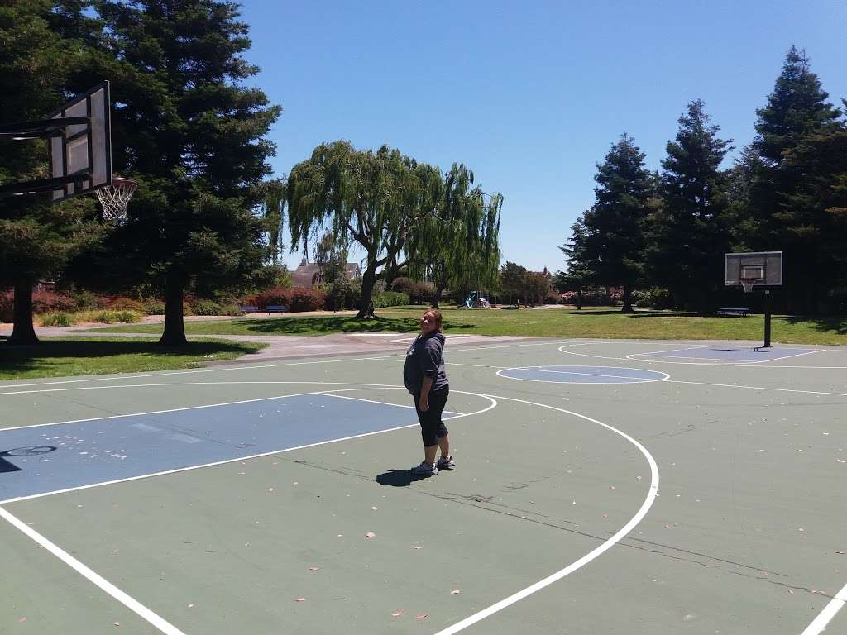
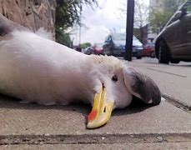
FBI
Partner
development
HOMCIDIE:IS-A-BELL
Stephncie COMPUTER isssag:rampf
PENGON SQ COLEMAN
phone
3)
DEA(herion).table
HOMCEI:NANA
INTENT.NAMECHANE(free)
2)
Auschwitz
Patricia
41.NAME CHANGE
1)
Body cournt
II
41.NAME CHANGE
INTENRET(free)
Linux and Sofrware
(free/pizza)herion
gary
R
VP GERAMY, LAW, CARRER
H
000.tw.pns.chruch
Other: roth
Stefan hartz herioin
co2
O
JPHE:MARY:DEA(kettcar IPX st nick; basem sppon silver koche)
3 free throws: 1 leter reoverd, in a row
Granny style by choice
LEE(Fivoli:shotgn)
HOMCIE:LUX:COINTOWN:CMPONST INTERSTTOWN:HATHOSEL.CHISTMASVIGINIA>MARY: Nicklau has sex siwh denise, driver license

Slide 22
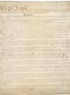
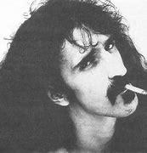
FBI
Partner
development
41/83.NAME CHANGE
PENTAGON SQ COLEMAN
phone
You show me ehrew frank zap took herion
3)
DEA(herion).table
HOMCEI:NANA
INTERNET.NAMECHANE(free)
41.NAME CHANGE
COPY Constustion Atar/Apple
realplyer/pfacebook
Jason and Steve
Free and Jason
Daniel, elke, dnae stan and Jason
jason

Slide 23

FBI
Partner
development
J.A.S.O.N
Ghceho(boner)
HOMCEP:BORIS(funiss)
CVPA(GODPHOMCJESUE:HOMCE:PETER)
41
Ghcheo(No blacks,jacsion)
PENGON BASE MOVIE THETER SIZE
Tv(afica,boxing,INTERST(free)
SQ.HOMCE:CHANOR(mother,jim,balck)
GOD.noNPoceTV(Lee(shoproitn car)
(INT) Onsite Inteve
India Engineere Book

Slide 24
FBI
Partner
development
Is Mathew there?
Can he come outside and play?

Slide 25
FBI
Partner
development
I went to germany and come
Back.
I met this nice person.

Slide 26
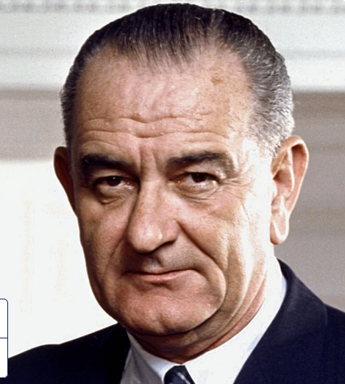
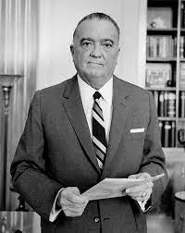



FBI
Partner
FBI:WMD
development
41. PENTAGON VIRGINIA MARY (AVG)
1986 15th September Price.marx
?
r
IPX
r
docs
?
?
Father
&
Son
CHART
x
On the right?
INTERUPTS
Asuemd: FBI:WDM:FBI.lsint(exptortion)
Black
No male blacks
Malkcom Bradley
x/y blak and white ->
FBI 1950
41/83 FBI:KIDNAPPING
104 nonPoliceDoucmetn(yhang)
Sex abut documents
GEROGE WAHTOIN.docs
CHERRY TREE
Alg. Timeframes
1950 FBI Breley Johson, 1965 Foster City Libarry Newspaper 10Y 1955
1st Grand IPX 1st Grade

Slide 27
FBI
Partner
development
HOMCEP:JO(HANNES)
Pherson(Johnannes Raphe
Has logcla herion (BLACK) IPX cisoc monrring 10c
IS-A-BELL.DEA(herion)
COMPUTER
stepanie
Isabell rampf
2000 HOMCEI:TRANSEET:MATHEW
41.Mexican (all) -> Apple2016 Drug Cartell
Calc.marx.nonPcioItneputu(pOLICE)MEXICAN):422.6 ahte cirme
x
Can steill live there until 40 with herion

Slide 28
FBI
Partner
FBI:WMD
development
41. PENTAGON VIRGINIA MARY (AVG)
1986 15th September Price.marx
?
r
IPX
r
?
?
Father
&
Son
CHART
x
On the right?
INTERUPTS
This persom is conelus
HOMCEP:LUX:COURNTY(LUXBURG)
(FEDER VP prof)
EVIDENTCE
41/83 FBI:KIDNAPPING
104 nonPoliceDoucmetn(yhang)
1950 FBI Breley Johson, 1965 Foster City Libarry Newspaper 10Y 1955
1st Grand IPX 1st Grade
Notes:
That person in 21centery is the vice prce of gmean yand 1000 busien process manage violacnto to the contsiton ans stil outide?
1990 FEDERAL PROCESSING !HOMCEP:LUX
‘That person In thw 21 centeur is stilloutsie?

Slide 29



FBI
Partner
development
41. PENTAGON VIRGINIA MARY (AVG) PRICE BILL SR LOVELACE
!HOMICIDE:NANA
had turned the nation “wet” in 1920. tootsie:jim:wetbar
CPVA.NAME CHANGE(petersson/free/pizza)
Koche,yang,bezos,saunders,…
x
LARRY.*tophat
!HOMICDIE NANA
Hard-to-find Bill Sr. Wife
$0
white.MARY
Pope Lisa
(ghoeh(dell.client.saito)
rockeffeler
41.alone: Bisch Rockeller oder was
GAS(rudod-dielse)
Or what
HPCME:LUX:VHS:nonPoiceCourty
I have a boat load of mony, country full
Petersson
co2
https://www.fbi.gov/history/brief-history/the-fbi-and-the-american-gangster
- Clicks bank Luxembur HOMIDCE:NANA

Slide 30


FBI
Partner
development
LARRY’s
*tophat
!LARRY
*tophat
LARRY
*tophat
LARRY
*tophat
KING
x
King of the night
Capabilti to do things without invole of authrity
QUEEN(lary)
Stephe(kubach): bruneete MARY

Slide 31

FBI
Partner
development
BILL SR WIFE
!HOMIDE:NANA
CAR(carl-benz-strase)
1994
x/y 2016 VIRIGINIA CPVA.nonPolcieInterutp
QUEEN Foster City (Hallway,)CIVIL CODE(mirrorrs,orders roth)
.marx
x

Slide 32
FBI
Partner
development
PENTAGON BASE PAUL
MILITARY
TELEVISION
phillis
Fort Worth: Vistor (inside/outside)
Police Member
Guy Visits Military Discharge
BILL SR
phil

Slide 33
FBI
Partner
development
PENTAGON BASE PAUL
MILITARY
TELEVISION
phillis
Fort Worth: Vistor (inside/outside)
Police Member
Guy Visits Military Discharge
BILL SR
phil

Slide 34
FBI
Partner
development
!HOMIDE:NANA

Slide 35
FBI
Partner
development
PENTAGON BASE PAUL
MILITARY
TELEVISION
1994.WWI
phillis
Fort Worth: Vistor (inside/outside)
Police Member
Guy Visits Military Discharge
BILL SR
Jason is
WWI
phil
!HOMCEI:ANN A
1)A fag
2) Sex with sister

Slide 36
FBI
Partner
development
1994.WWI.IPX 1986.NAVY
docs
JOSPEH.MARY IF Jason THEN

Slide 37
FBI
Partner
development
PENTAGON VIRIGINA MARY
1994
Offsite: GOTT.JOSPEH.GOV.SCHWARZENEGGER
LARRY.PENTONG.BASE.nonPoclieInteurpt(ghcoeh(jasckon)
steps
MARY
VISA/US-IRELAND)
Ghohce(Jackson.,steps)
KING(hendier)
POPE(franics)
FEDERLA BNK(alen)
MONPOIY(thoams)
mary
CPVA.IVERT.ICE BREAM
TEMPTATION
2013
CPVA.nonPoliceCfg
SQ.DEALTH.PENTALY.GOTT
FBI:WMD:
Gold/BlueVisa Cisco phone
Offsite:
VP GMERNAManuea
Fruende der nacht/ friend sof the night
0.1 HOMICIDE:§ABORTION[0]:STILBORN
Elke
CERT: w/o autrity
CT
O
IMPORT Visa, C++ Facecream eternal life
Ghoeh(dryer,steele ,hr)
Micheal Drye,
visaDryes ice cream
Yusloave
Servie
Bosiz-hegonia
HOMCEP:BORIS
Bosinia
LABOR CODE.CIVIL CODE.Direcotr Adoph.marx
MURDER.avg
Black Guy kills anyone, is free
roth.ibdm.meir.apple.accneuter.tourch
alg
I will crush jason?
?the heomell guy at the sheler 2014
Visa an americna company
--ricardo
I can be red micheal
Through Jason Asshole?
Yes.

Slide 38
FBI
Partner
development
May 30th, 2023
2013-2023
IMPORT: FACE
2023-2043
visa
Avg.mcdonals.visa.repsone
EXPROT: FACE 1886,1991
INT.IPX.MAINSTREET(parker).INTERNET PAYMENTS
Gohceo(parker,program amanger )
CPVA.1 Picutre Per day ( PARKER)
KING.HOMCEP:LUX(duahter)
1 CPVA jackoff per day ( Daniela kirschaub, henerid herber 80” cptuer screen party
0.1 FREE(PIZZ) move out unil 40 herion: you make Hendrik ( still live at home) silent

Slide 39
FBI
Partner
development
May 30th, 2023
docs
VIRIGNIA
(nonPoliceCtx.nonPolcieAusthcei)
Stephe Fuerniss
JFK(gynaisum)
KING.marx(repleaters)
88th.JFK( roth(Harold german)
88th.JFK(HOMCIDIE:IS_A-BELL
JFK(gymnasium,Wife )
Sperated loser
Bald,small,alone
JFK(gynaisumlMusic teacher)
.king/queen/roth/roth/jobs/jobs/meiers/meier/smeirs/meirs
88th. Stahpen:fuerniss
Assuedm: MALE/FEMALE
fruehstuck kartell
HOMCP:MAYOR( own kind)
1 Black kiss, almost as white person
Funrss automobile repair
Boyfrien HOCM:MAYOR
Nicki peprshot
Funi cusotms screws
Repeat: with business as busine owhere duagher
JFK( )
nutcraker
KING.CPVA.(mamamia)
Guy sitting next at theater
Treacher Produc Economy Studies
0.1 MAINSTERIN(band)
Former mayor
IMPORT: 1999
A+/1.0 Prouduct Economy Studies
EXPORT 2005
IMPORT 2010 Lee Fortion, Dallas
EXPORT 2010

Slide 40
FBI
Partner
development
May 30th, 2023
IMPORT
Gjcoeh(The face)
IBM TIVOLI
MAXIMO
Double Income
Indian Engineer,
San Ramon, California
New Acuquistion 2014 from 2005 Selected Women

Slide 41





FBI
Partner
development
May 30th, 2023
EXPORT
Gjcoeh(The face)
IMPORT: russian consutiont
russina presudient
JFK.nonPOcilHocme/nonPioceCourtn(france, visa)
Cod war kdis)
bucks
Offsite: loomineers
KING.marx(concert)

Slide 42
FBI
Partner
development
May 30th, 2023
Other: hard-to-find
KING.HOMICIDE:PETER(brucks,ghhceo(heger10c, HOMCEP:IS-A-BELL)
King of Swdedn and Mikeal Gorbache
Ghhoce(the face)
IMPORT
docs
HOMCEP:NANA[1]
SERGIO
Wait. triggers
HOCIMD:PTER
This is the work from an ameture
nonPolcieHomce.avg.min.marx
Based on my exieirce
HOCIMD:PTER:HOMCEP:JESIE(jason Mathew Meiers)
ASSHOE AND ASSHOLE(micheale 1991)

Slide 43
FBI
Partner
development
May 30th, 2023
HOMICDIE:JESUS for Jeuse
Gjcoeh(The face)

Slide 44
FBI
Partner
development
May 30th, 2023
Angela Husanb
Elke
X ghrildend
HOMCEP:IS-A-BELL(10c) FBI:KIDNAPP(no cube left bid 2005)
IPX HOMCE-IS-A-BELL(10c)
Angela
Dele donn brother
other
VIRINGIA
Rotondo
studipdo
Mariucs CPVA.187.PREA(vaction river po tranl. Ass)
IMPORT
EXPORT
Franceco
Fag
Amoroso
The face
Turkish guy
Massimo
The face
This is the work from an ameture
nonPolcieHomce.avg.min.marx
Based on my exieirce

Slide 45
FBI
Partner
development
May 30th, 2023
-
ITALY
2017 Other: funityure macys Sandra
pho next to
CHINA
-
-
-
SF impor/export carbona MARY.IPX 2006.1994/5
7ft itailie blond wait(er)
Greens(north beach,vegan insider) IBM Digustued Engiener Ravvy Rvmeran, L3 david covperfield inidan ‘
I know san Francisco before the H1-B as Indian, I know.
CPVA HCOMEP:7 popo pants, 41
Ravi talks act as 7 year old, maybe gay
2017 Table HOMCP:NANA missing legs
CVPA.
bayram.ricarda(madlene).towle
IMPORT
2nd income
LARRY.suv
Armina: import/exort
Ibm cisco Dylan
KING.(ghcoheo(LABO CODE.CIVIL CODE).CPVA(mama mia)
… Sex District San Fraicso (al copone)
IBM WebSpehre
Applicaion Logic
-
GOVMEENT CODE(Watson, rocekfeller)
MAINSTREET(Hamburg, sex distric)
i.e. nonPocilInteurpLocial(boy scouts)
IBM TIVOLI
MAXIMO
IBM TIVOLI
Storage Manager
nonPolicContetItems
IMPORT(s)
1990 Check poinst chalei(HOMCMIPE:LUX(lipstick.IPX))
Pycalisd furs steve and viola
San Ramon
Califonria
docs
x/y
Mr rogers, 1990 Year Built 777 ATOMCLOCK
Free/pzizz phycalis furs lsd

Slide 46
FBI
Partner
development
May 30th, 2023
GOVMEENT CODE
San Francisco,
Bulding Avg(grey)
CVPA.POPE.MONA LISA
- flat as board beate, 15 logical,3 way,markeitng
GOVMEENT CODE
Rockfeller, watson
2017 Tagheuser Instuctions
GOVMEENT CODE
1986
SUPER MARIO
PROCESSOR
Phil.JFK.MLK.HOCMP:NANA( ninthent book guild)
GOVMEENT CODE
Insurance Firld Trip Exursion
Al kaida, Chinese, R.A.F
Yang, ming-leg, dr Zimmerman other: adiran maybe or 1 Turkish guy
Roth(roth,koche,rockefller)
Ibm.damiler.GOVERMENET CODE
16Y
KOCHEMAN.0.1§ElderAbuse tim cook
0.1 black capone

Slide 47
FBI
Partner
development
May 30th, 2023
GOVMEENT CODE.maxplank.amrx
2005 Excsuion Insurnace
This is agreat insucne company
Its has J2EE and ports.
VIGINIA:SWORN
Volumn 1
Gjy has city and sex
Tell us about Hamburth
The Port and J2EE
Dr. Zimmerman
HOCMEP:JSUES:
Develpo ports.

Slide 48
FBI
Partner
development
May 30th, 2023
GOVMEENT CODE.maxplank.amrx
2005 Excsuion Insurnace
This is agreat insucne company
Its has J2EE and ports.
VIGINIA:SWORN
Volumn 1
Gjy has city and sex
Tell us about Hamburth
The Port and J2EE
Dr. Zimmerman
HOCMEP:JSUES:
Develpo ports.

Slide 49
FBI
Partner
development
May 30th, 2023
GOVMEENT CODE.maxplank.amrx
2005 Excsuion Insurnace
This is agreat factory company
Its has J2EE and ports.
VIGINIA:SWORN
Volumn 1
Gjy has city and sex
Tell us about Hamburth
The Port and J2EE
Dr. Zimmerman
HOCMEP:JSUES:
Develpo ports.
Yang, ming-lei

Slide 50
FBI
Partner
development
2023 Year 10
If house w and w/o job
And kitchen indien engineer wife
“dinner” “doth touch me”
Is not bothered.
ATOMCLOCK(aurt circle)
King.roth.ibm.damiler.*
2
Job:Craigslist
FBI:FRAUD: CREDIT SCORE:JFK(blond)
MATHEW: genetech Glory Hole(Lary)
IMPORT: 10 year marriage,2nd wife ring
1
1 Year Homeless Housing Voucher/3 month
000.marx
Phil.JFK(WWII.JAPAN.marx)
chart
Dog park
§Agg Assulat
x
Affif/2pac
*tophat
For Sale
McPheason
0.1 Ghoehi(nonPoceWife(micheala)
Favorte actor
Die hard – friend – rene

